Slide 1
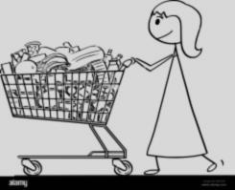
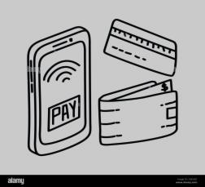
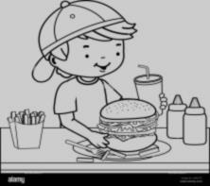


Buying Fruits and Vegetables Journey Map
USER JOURNEY MAP | Check Available and Prepare List To Buy | Take Vehicle And Check Fuel | Take the List And Buy The Listed Item | Head To Payment Location To Settle Bill | Drive Vehicle To Reach Home | Bring Purchased Items
 | Choose The Shop To Buy An Snacks | Drive Vehicle And Cross Signal | Compare The Item Price with Another Shop | Give Purchased Item To Generate An Bill | Cross Signals | Separate The Fruits And Vegetables
 | Ensure Your Available Money | Park The Vehicle In Parking Area | Also Ensure The Fruits And Vegetables Quality | Pay By Cash / Card | Drop Vehicle In Home | Place the Fruits And Vegetables In Container / Fridge
Buying Fruits and Vegetables
Plan to buy Fruits & Vegetables
Commute
Buying
Payments
Commute
Keep Things In Container

Slide 2
🙂
😐
😕
🥺
😞

